Slide 1
MANUFACTURING OF IC'S

Slide 2
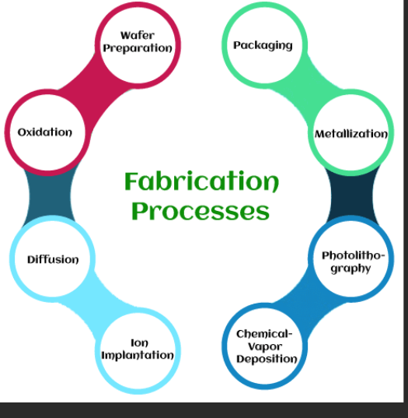
IC Fabrication Process:

Slide 3
PHOTOLITHOGRAPHY:
Photolithography is an integrated circuit fabrication process which plays an important role in the fabrication of different devices or different structures on devices. The photolithography process imprints the specific pattern on the wafer.
Photolithography is also known as optical lithography, using light to produce thin films. It is used to pattern thin films on the substrate, such as silicon wafers. It protects certain areas during successive fabrication processes (deposition, ion implantation, etc.). The types of light used to introduce mask patterns on the silicon wafer include UV light, X-rays, and extreme UV that emits at different frequencies. The most used type of light to produce the film is Ultra-Violet light.

Slide 4
1
The silicon wafer or the substrate is first coated with a photoresist. On the photoresist layer, a mask pattern with the help of photolithography is applied to the silicon wafer. The exposed areas of the wafer become soft and can be removed. It creates a pattern on the wafer. The wavelength of each type of light determines the feature size impressed on the photoresist.
Photolithography is somewhat similar to photography because the exposed area is patterned with help of the light. The incident light can be direct or projected through the lens.

Slide 5
EPITAXY:
Epitaxy is a method of growing or depositing thin films of crystals on a substrate, which is usually another crystal. The film and the substrate have the same or similar crystal structure, which means they are aligned in a specific orientation.
Epitaxy is used in semiconductor fabrication to create high-quality layers of materials with desired electrical properties. There are two main types of epitaxy: homoepitaxy and heteroepitaxy.
Homoepitaxy is when the film and the substrate are made of the same material, such as silicon on silicon.
Heteroepitaxy is when the film and the substrate are made of different materials, such as silicon-germanium on silicon.
Epitaxy can be performed using various techniques, such as vapor-phase epitaxy (VPE), liquid-phase epitaxy (LPE), or molecular-beam epitaxy (MBE). Each technique has its own advantages and disadvantages, depending on the materials, quality, and cost involved.

Slide 6
WHY IS EPITAXY USED IN SEMICONDUCTOR FABRICATION?
Epitaxy is used in semiconductor fabrication to create a perfect crystalline foundation layer on which to build a semiconductor device, to deposit a crystalline film with engineered electrical properties, or to alter mechanical attributes of an underlayer in a way that improves its electrical conductivity.

Slide 7
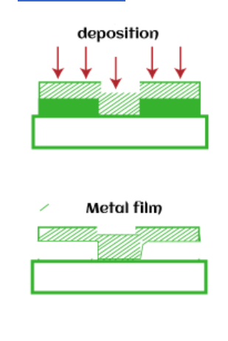
METALLIZATION:
Metallization is defined as the process of coating a metal layer on the metallic surface or non-metallic surface. The coating can be of aluminum, zinc, or silver. The metal coating in CMOS fabrication is aluminum, which protects the surface from external environmental factors, as dust, air, water, etc.

Slide 8
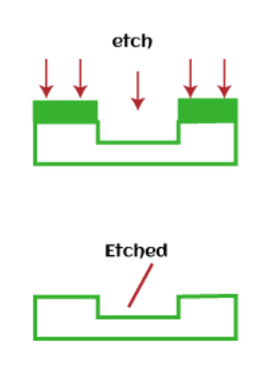
1
Metallization is also used to interconnect various components that form an Integrated circuit. The components can be resistors, capacitors, transistors, relays, etc. The metal layer is first deposited on the surface of the silicon wafer, as discussed above. After that, the required pattern or area for interconnected is etched, as shown below:
The metallization process uses chamber to apply metal layer. The wafer is placed inside the chamber, which coats the entire surface inside it. The thickness of the metal layer can vary depending on the requirements.

Slide 9
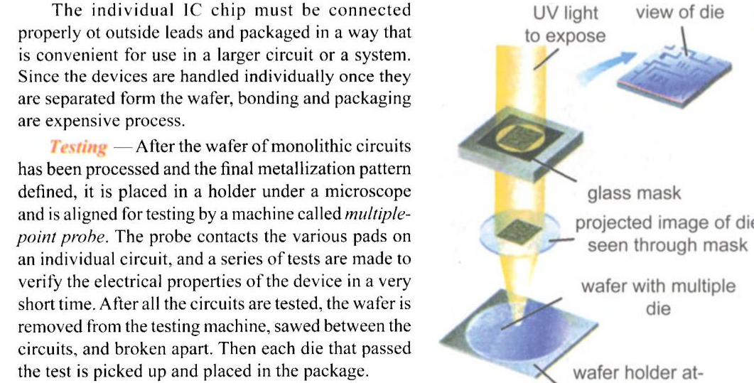
TESTING OF IC'S:

Slide 10
BONDING AND PACKAGING:
Bonding and packaging of ICs is a crucial step in the fabrication process. After the wafer has been processed and the final metallization pattern defined, it is placed in a holder under a microscope and is aligned for testing by a multiple-point probe. The probe contacts the various pads on an individual circuit and a series of tests are made of the electrical properties of the device. The various tests are conducted automatically in a very short time ranging from a few milliseconds for a simple circuit to 30 seconds or more for a complex chip. After the testing process, information from tests on each circuit can be printed out to facilitate analysis of the rejected ones or to evaluate the fabrication process for possible modification.

Slide 11
Once the chip is tested, it is mounted on a substrate using die bonding. Heat and a slight scrubbing motion are applied to form an alloyed bond holding the chip firmly to the substrate. Interconnecting wires are attached from the various contact pads on the IC to the posts on the lead frame, a process termed wire bonding.
PACKAGING:
Packaging is the last stage of the IC fabrication process. The finished silicon wafer or chips of various sizes with number of small components are tested electrically to recheck their working.

Slide 12
Packaging also assembles the ICs with other devices. IC is a component of a device. The external connections with the IC are packed together to form a device. We can also say that packaging is a connection between the manufacturing and end use of a device. It makes a product suitable for its end use.
The individual chip cannot be directly handled because it is very small and brittle. Hence it is soldered to a gold plated header through which leads have already been connected.
The package is finally sealed with epoxy or plastic to prevent it from atmospheric dust. It is performed under vacuum or an inert atmosphere, which prevents the material from oxygen that may get trap in the packaging.

Slide 13
Integrated circuits (ICs) are complex semiconductor devices that contain various electronic components, including resistors, capacitors, and diodes, all formed on a single silicon substrate. Here's a brief overview of how these components are typically formed in ICs:
Resistors:
Passive resistors in ICs are often made using a thin film or thick film technology. Thin film resistors are created by depositing a thin layer of resistive material (usually nichrome or tantalum nitride) onto the silicon wafer and then patterning it using photolithography. Thick film resistors are created by screen-printing a resistive paste onto the wafer.
The resistive material's thickness and length determine the resistance value. By controlling the deposition process, different resistance values can be achieved.

Slide 14
1
Capacitors in ICs are typically formed as metal-insulator-metal (MIM) capacitors. An insulating material (usually silicon dioxide or silicon nitride) is sandwiched between two metal plates.
The capacitance value is determined by the area of the plates, the dielectric material's permittivity, and the thickness of the insulator. Photolithography and etching processes are used to define the capacitor's dimensions.
Diodes in ICs are often created using pn junctions, similar to discrete diodes. This involves the diffusion or ion implantation of specific dopants into the silicon substrate to create the desired semiconductor junction.
The type of diode (e.g., Schottky diode, p-n junction diode) and its characteristics are determined by the doping profiles and the physical structure of the diode.
These processes are integrated into the overall semiconductor fabrication process used to create ICs. The precise techniques and materials may vary depending on the IC's technology node and design requirements. The use of advanced lithography and fabrication techniques allows for the miniaturization of these components in modern ICs, enabling the creation of highly compact and powerful electronic devices.

Slide 15
APPLICATIONS OF IC'S:
Integrated circuits (ICs) are used in a wide range of applications.
They are used in devices such as wristwatches ,computers, televisions, juice makers, radar, audio amplifiers, microwave amplifiers, small signal amplifiers, radiofrequency decoders and encoders, voltage regulators, timers, clock chips, calculators, flip-flops and many more.
ICs are the key to all electronics and have revolutionized the electronics industry by making it possible to create smaller and more powerful devices.

